Slide 1

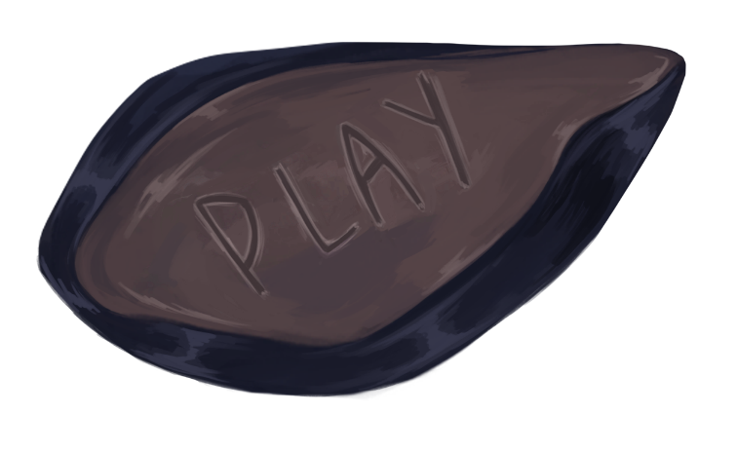
FORGET ME NOT
BY DANIEL BARACOTTI, FREDERYK SPERLING, Alba Pläp Golfe, Sebastian gerena and tamina Brunke

Slide 2
Target Group
15-25 years old
Casual Gamers
The game as a possibility to relief stress and have an enjoyable experience without much expertise
Pc gamer

Slide 3






Artist Provide Character and Background sprites
Designer Create level ideas and build levels
Programmer implements the scripts
Development
Artists
Designers
Programmer
Character design &
animation
Game mechanics
mechanics and asset implementation
puzzles
Environment & asset design
Level design
Level builder

Slide 4
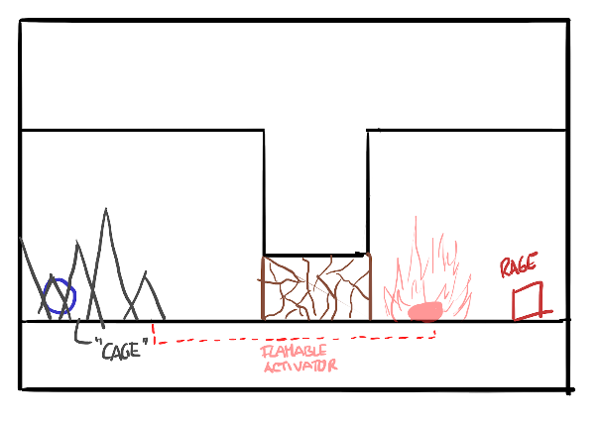
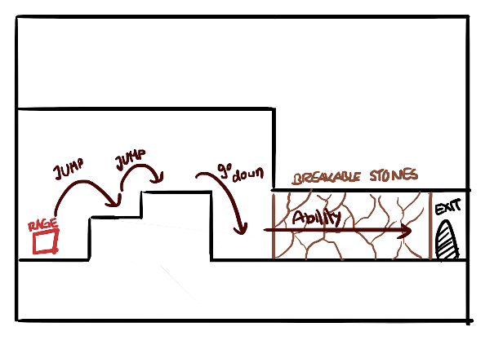
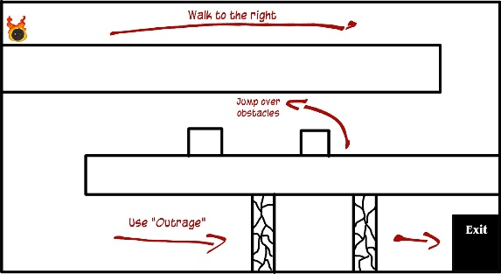
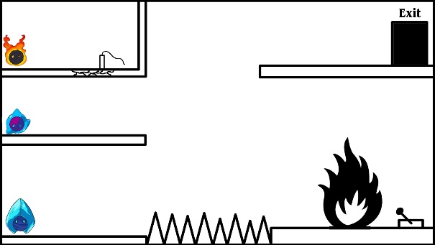
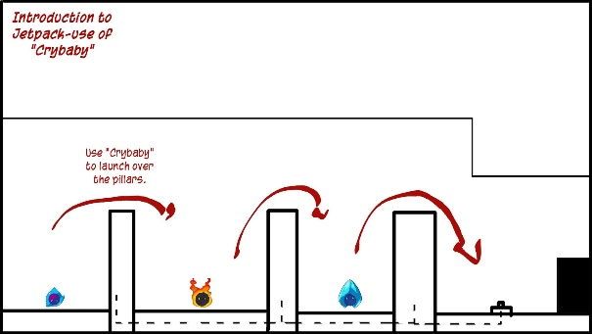
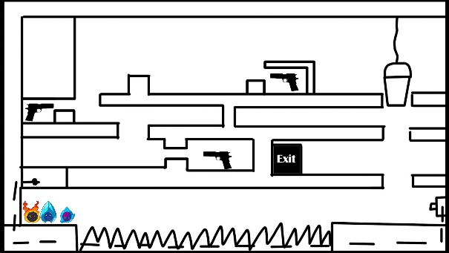
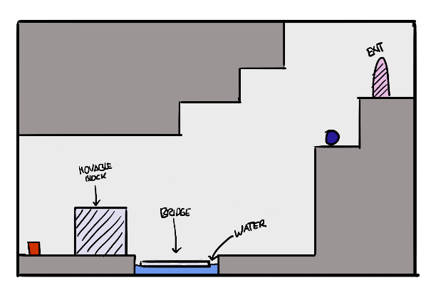
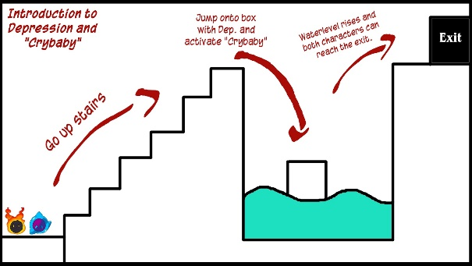
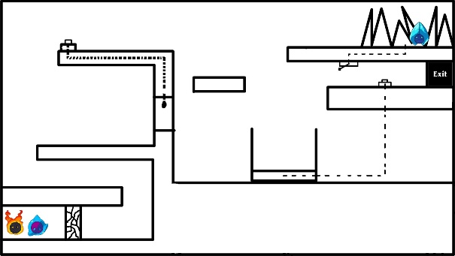
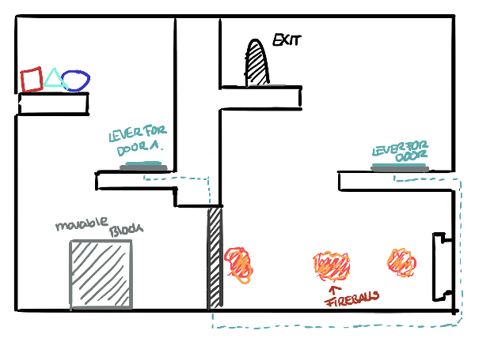
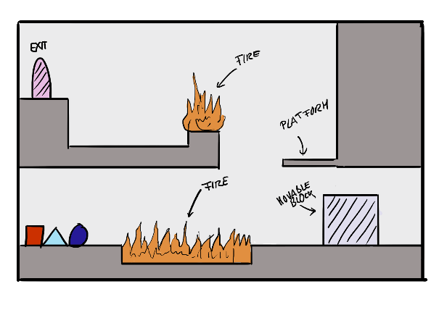
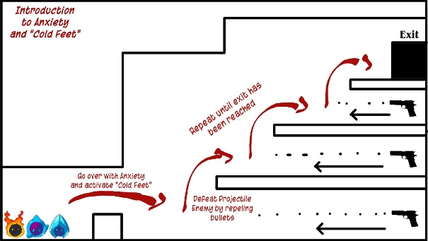
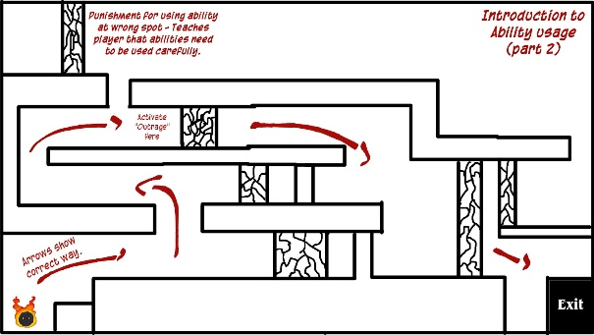
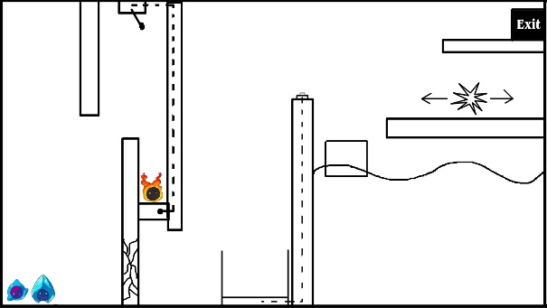
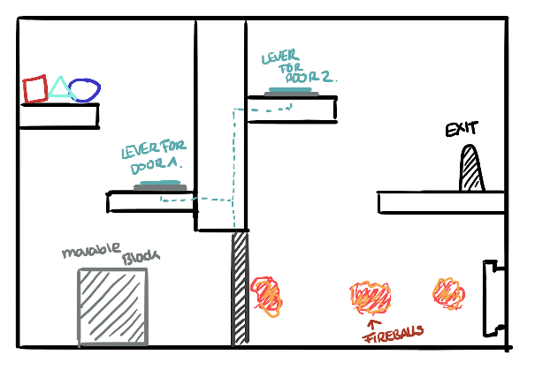
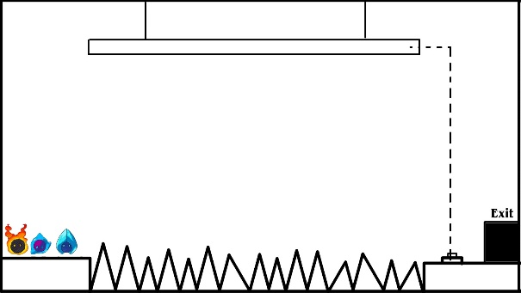
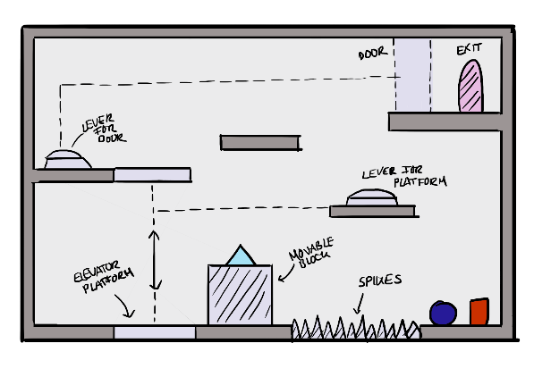
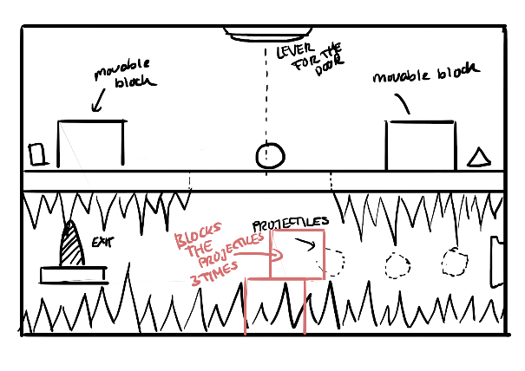
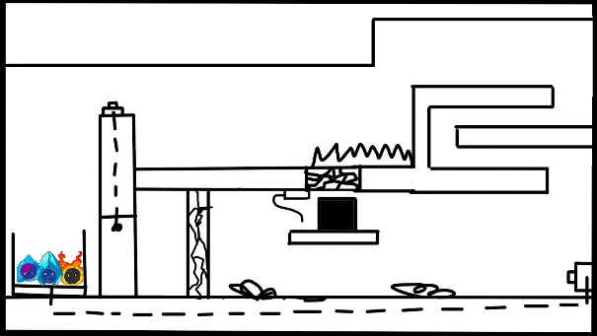
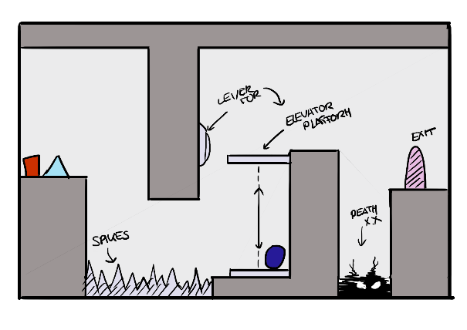
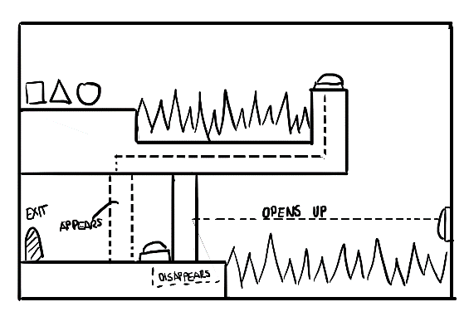
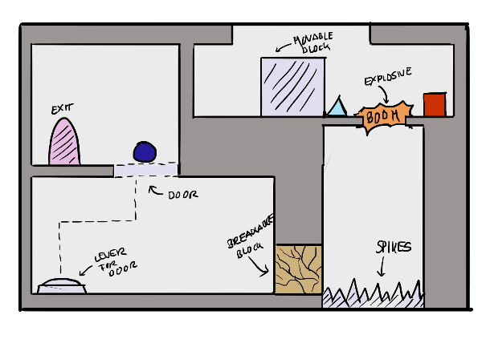
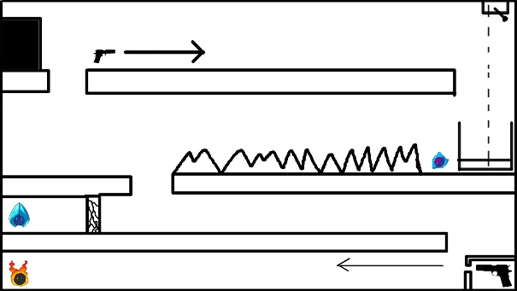
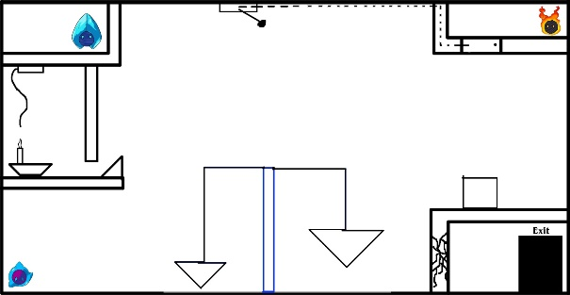
puzzles

Slide 5
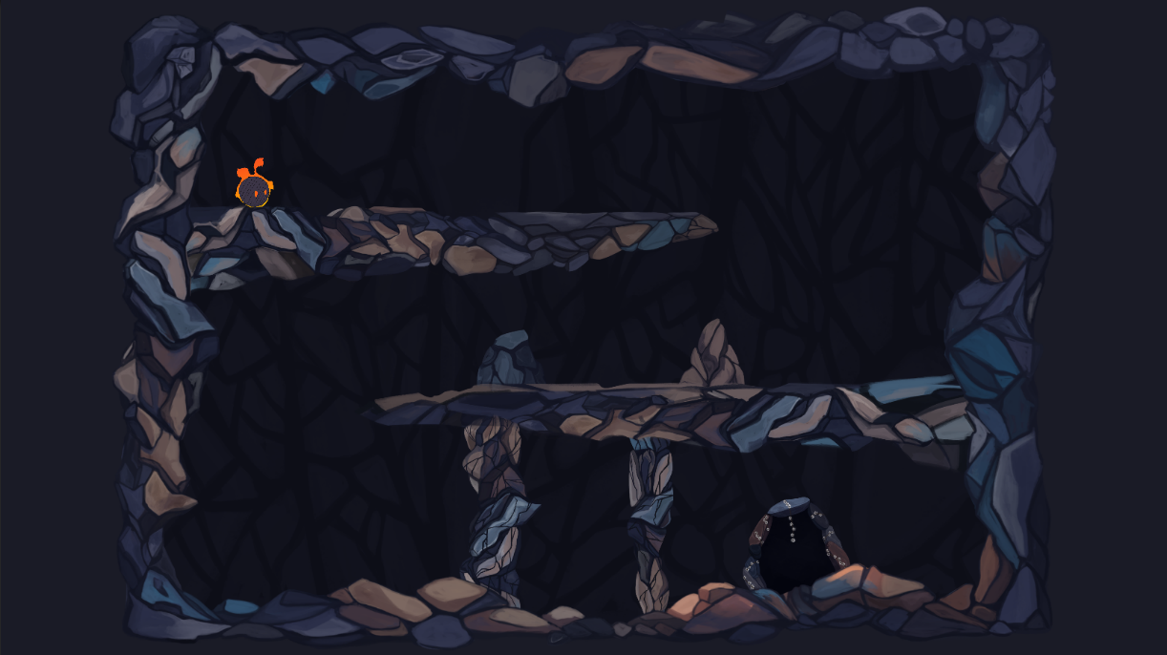
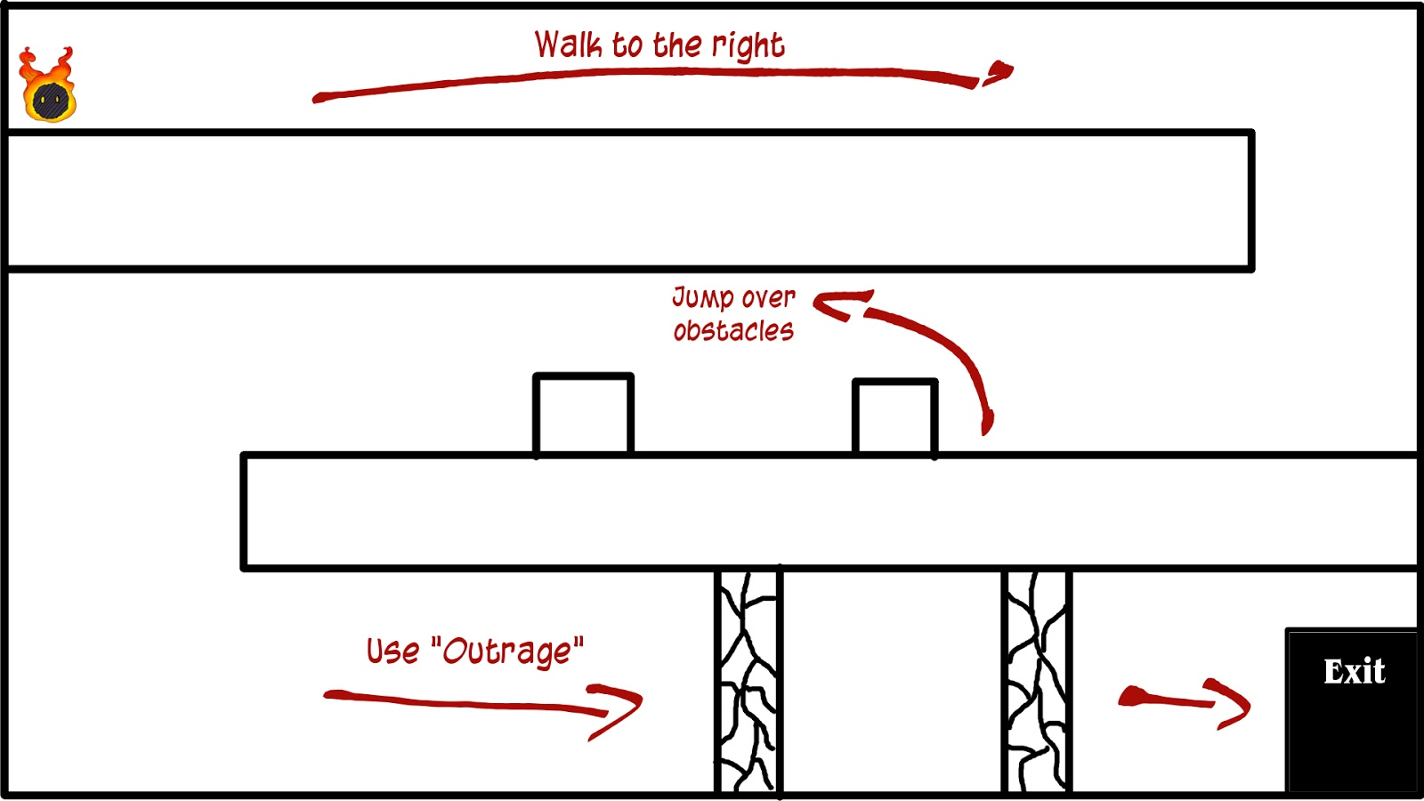
Levels

Slide 6
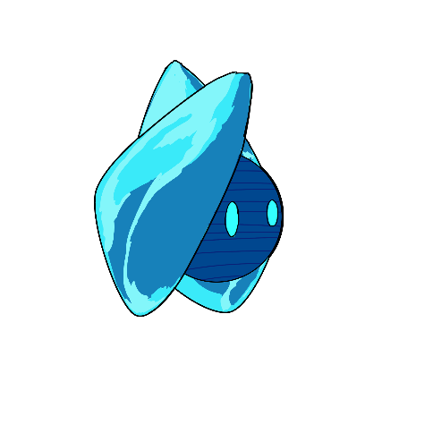
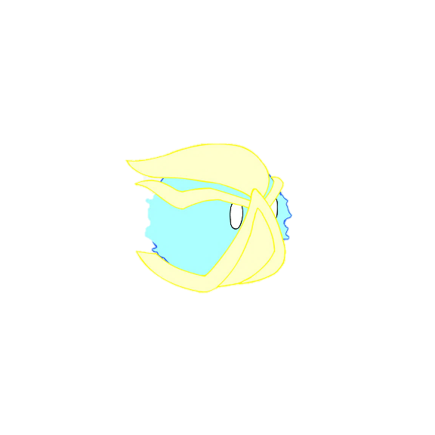
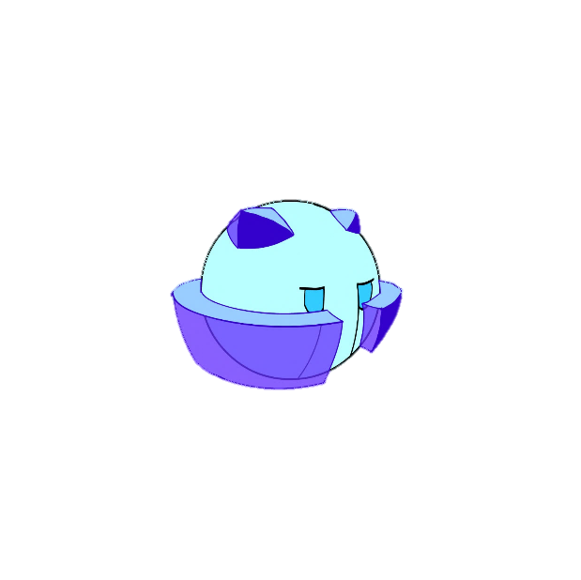

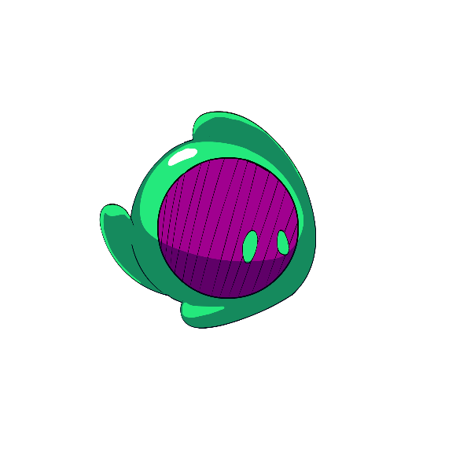
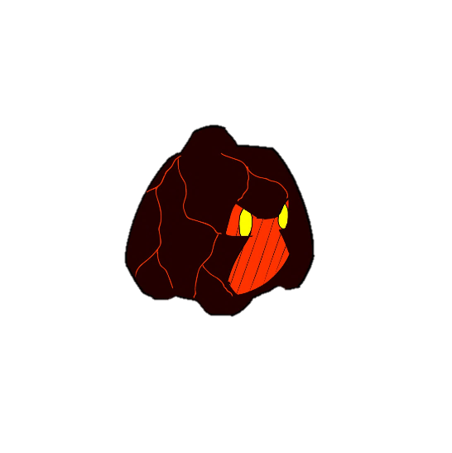
Anxiety
Rage+Anxiety
Anxiety + Depression
Rage
depression
rage + depression

Slide 7



Individual abilities
Rampage
A forward dash making rage’s flames burn stronger
run through breakable obstacles
light flammable objects
Activate explosives
Cold Feet
Makes Anxiety freeze in place.
immovable
Repel projectiles
invulnerable
Can be used as a platform
Crybaby
Makes Depression cry a huge amount of tears.
fill up containers
put out fires
raise water levels
Tear jet-pack

Slide 8
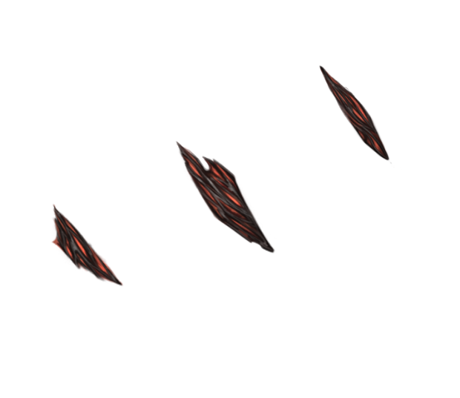

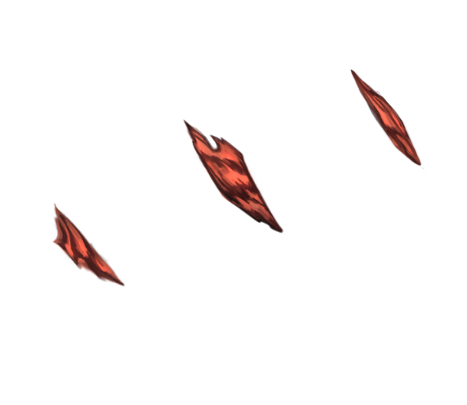
combined abilities
Eruption (Rage&Dep.):
cries magma tears, that harden immediately.
Can be used to create paths
Frozen Outrage (Rage&Anx.):
runs very fast and becomes invulnerable
Can run over hazardous terrain
Can run through enemies to defeat them
Icey Tears (Dep.& Anx.):
can shoot controllable frozen tears.
Can defeat enemies from a distance
Can activate otherwise unreachable mechanisms

Slide 9
Unity Project Structure
Character > separate into character baseclass and specific subclasses
Level builder > scene with integrated design manager > add interactibles > drag n drop
Interactables > prefabs w/ scripts and sprites, interactable base class
> Enemies (monsters, spikes, projectiles)
> Projectiles (tears, enemy bullets)
> Platforms (platforms, pillars)

Slide 10
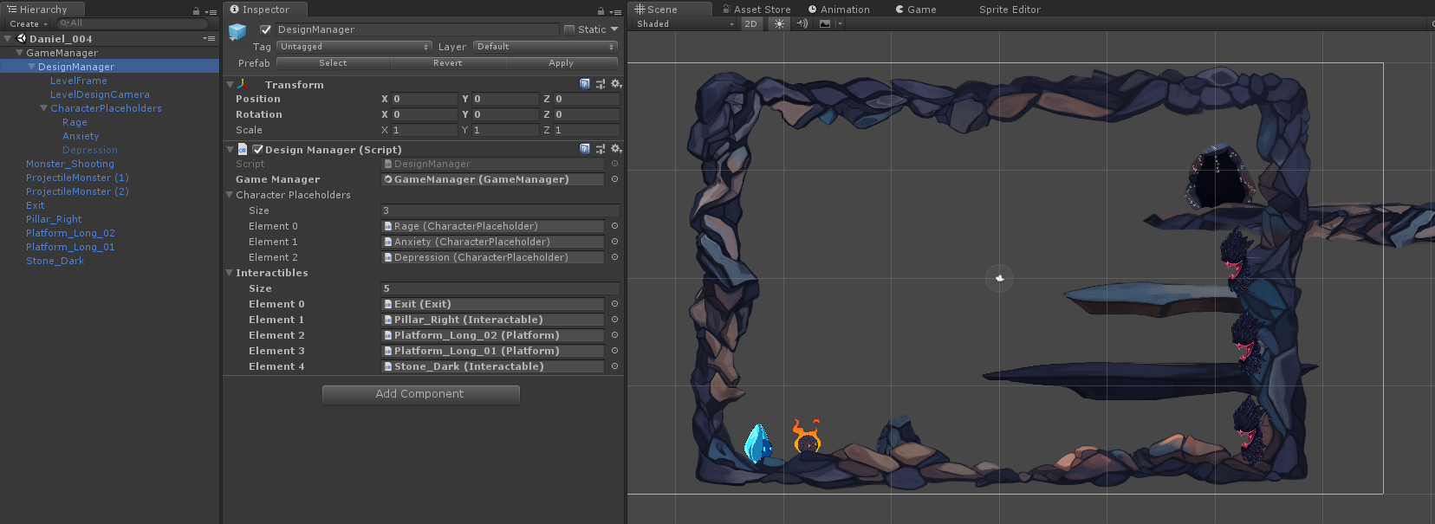
Unity Project Structure
level builder > scene with integrated design manager > add interactibles > drag n drop

Slide 11
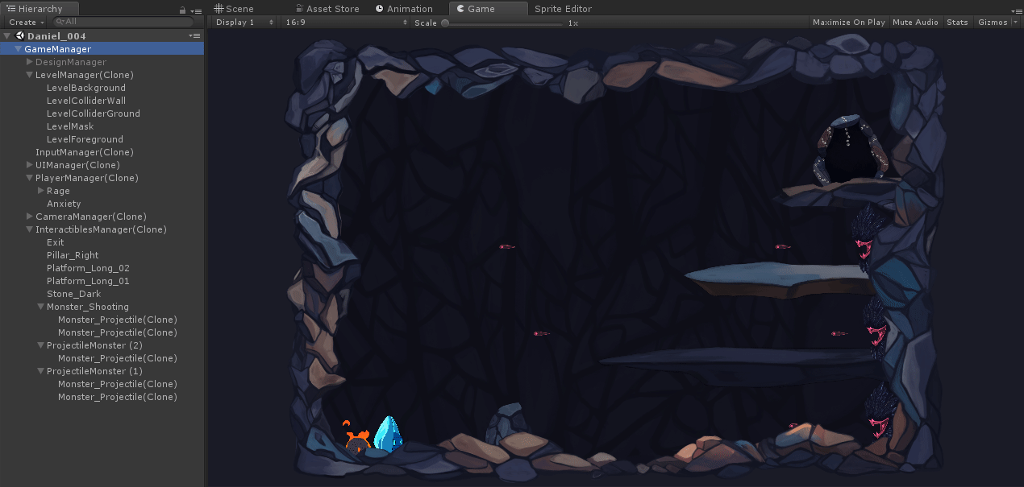
Unity Project Structure
level builder > moves all objects to interactables manager at runtime

Slide 12


Character Animations
rage

Slide 13
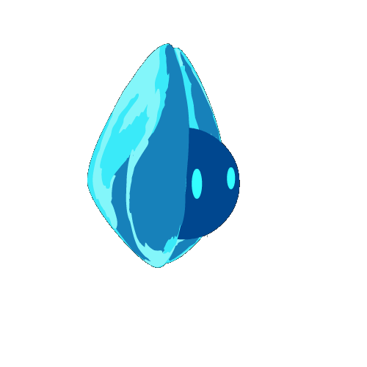

Character Animations
Anxiety

Slide 14
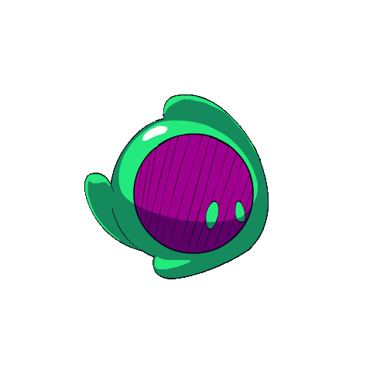
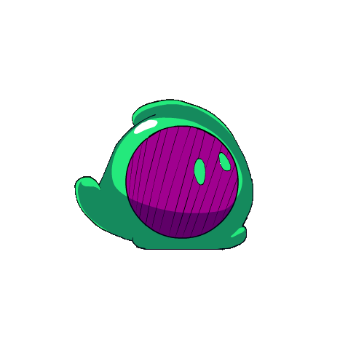
Character Animations
depression

Slide 15
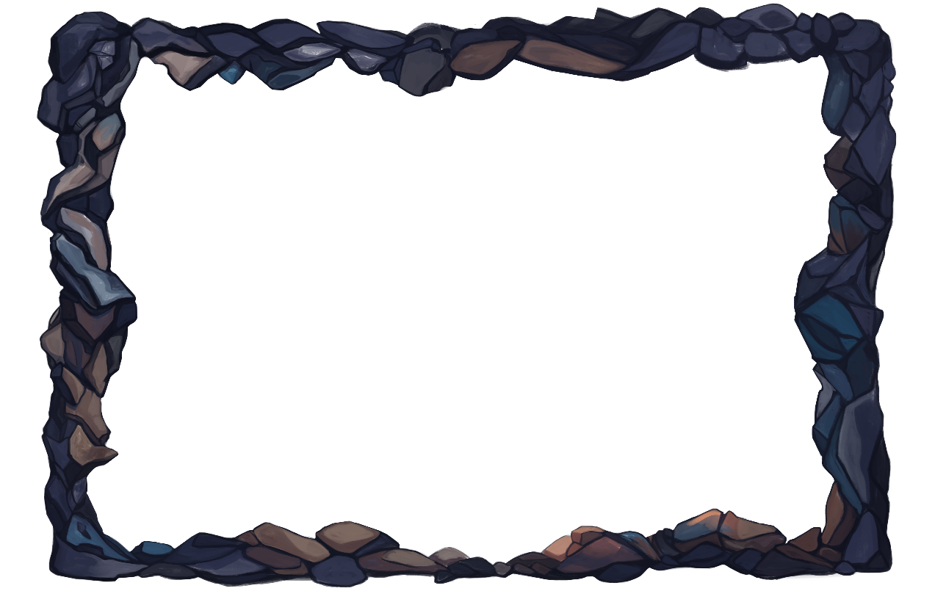

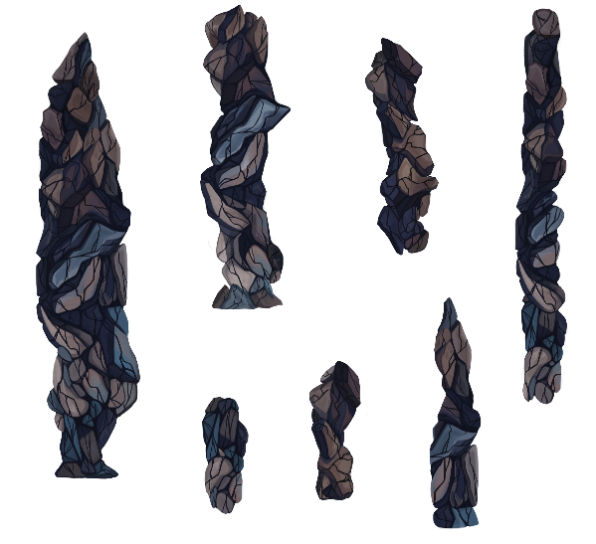
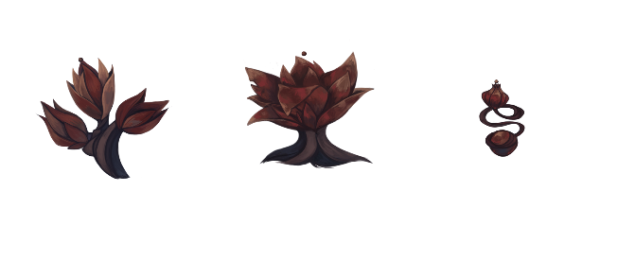
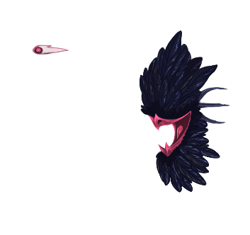

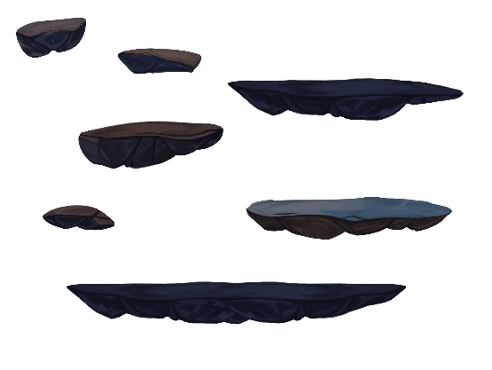
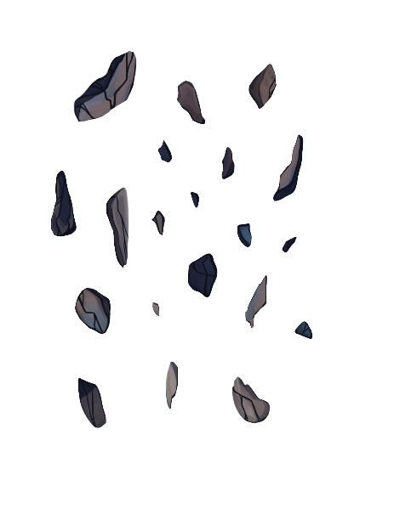
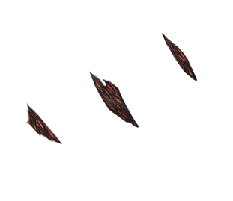
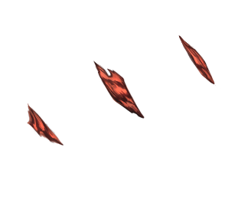
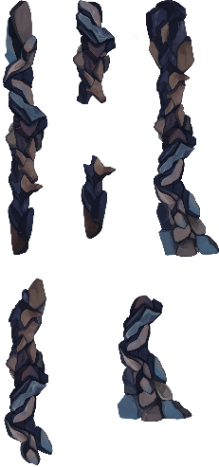
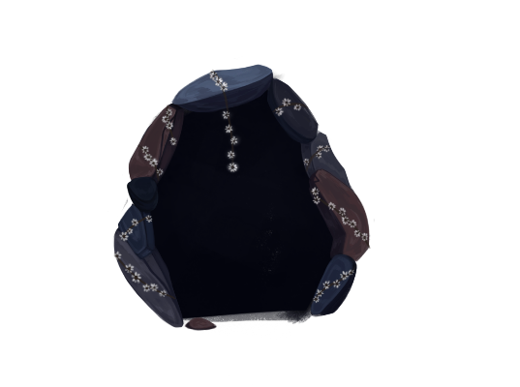
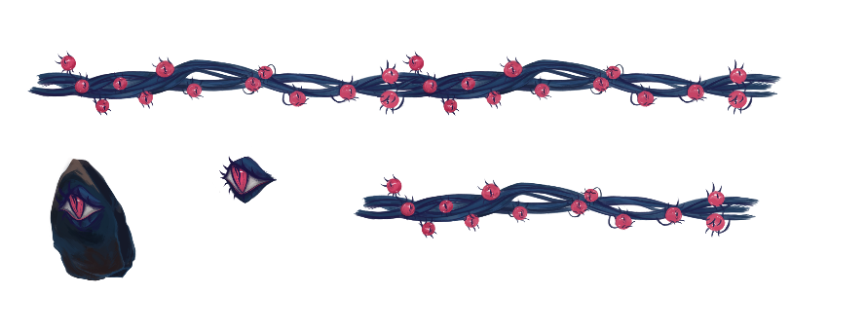
assets

Slide 16






interactables
Fuses
Connect interactable objects
Eye switch
can activate or deactivate interactables like doors or moving platforms
Explosive mushrooms
explode when set on fire
Shooting flower
shoots harmful projectiles
Fire flower
Friendly helper emitting flames
spikes
You touch them – you die.

Slide 17
Selling Points
Characters can use both individual and combined abilities!
Creative and unconventional solutions are encouraged!
Broad abilities allow for lots of experimentation!

Slide 18

Daniel Baracotti (Level Design/ Mechanic Design/Documentation) : daniel.baracotti@web.de
Tamina Brunke (Level Design/Framework): taminabrunke@outlook.com
Sebastian Gerena (Character Design/Illustrations): belmontx21@hotmail.com
Alba Plaep Golfe (Project Lead/Environment Design/Illustrations): alba.plaep@gmx.de
Frederyk Sperling(Programming/Sound Design): mail@frederyk.de
Moon flower bold
A b c d e f g h I j k l m n o p Q r s t u v w x y z
FORGET ME NOT…

